Slide 1
King County House Prices
Michael Moravetz
Predicting House prices in King County Washington

Slide 2

The Data
King County House dataset
21 features
Includes:
Sales prices between 2014 and 2015
Location
Size
Grade
Renovation details
Date sold
Number of times viewed

Slide 3
Important factors for house prices
Size, location
Grade
Time of year
Renovations
Number of views

Slide 4
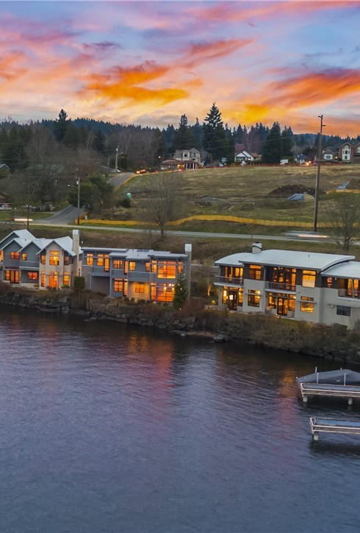
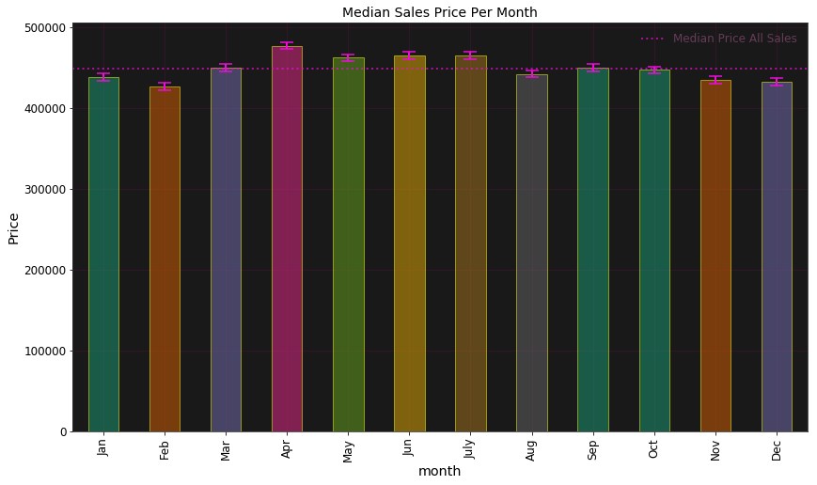
Effect of Month Sold on Price

Slide 5
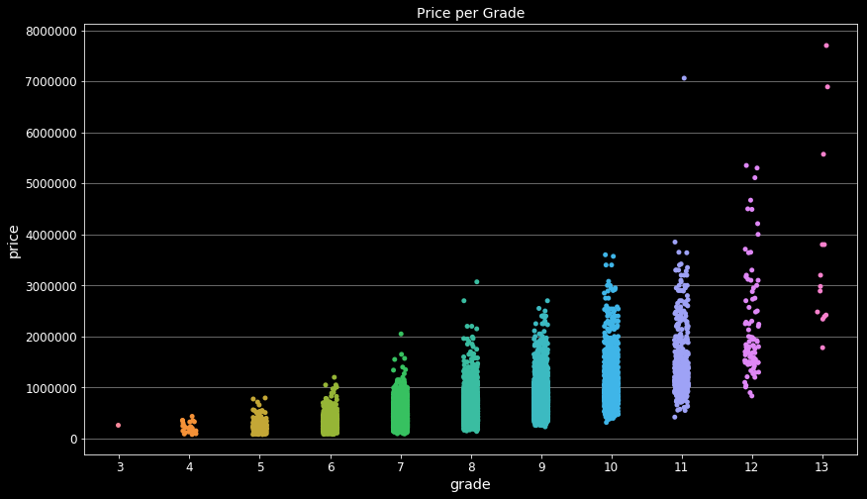
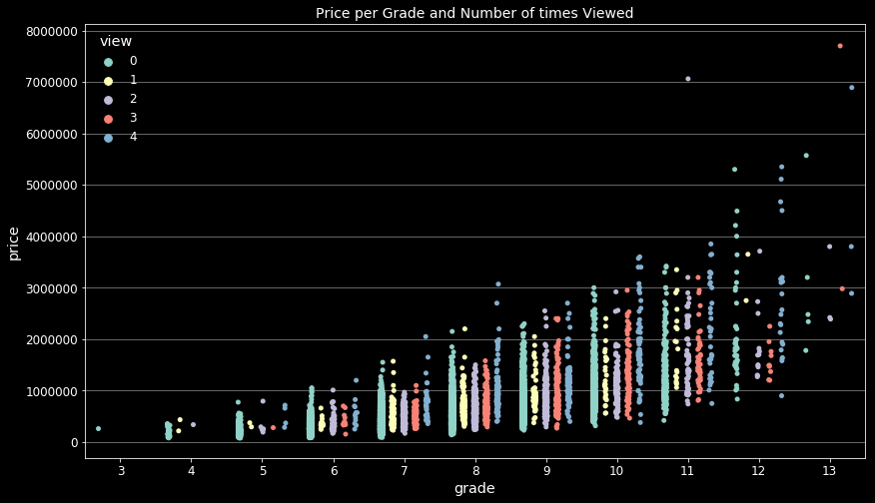
Effect of Grade on Price - Does the number of times viewed play a roll?
As grade increases price increase
Houses viewed more often sell for higher prices.

Slide 6
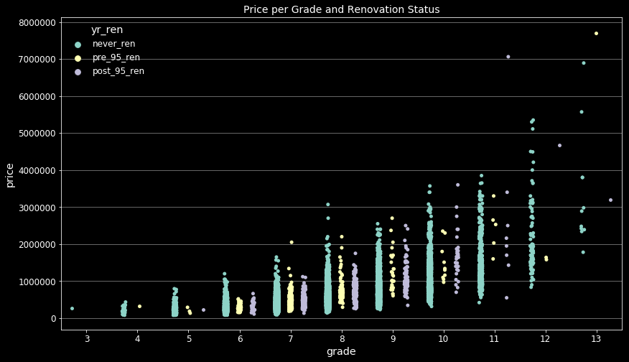
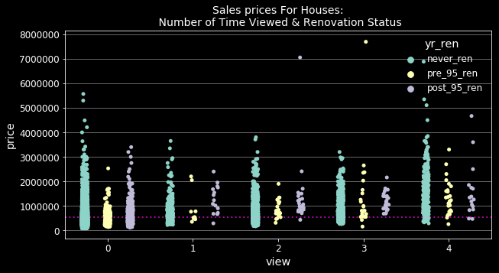
Effect of Grade and renovations - How do these affect views?
Many of the higher grade houses have never had renovations. Many mid grade houses have had renovations either recently or in the past. Grade 7 is the most sold grade of house and contains the highest percentage of renovated houses. It could be that without those renovations, they would have been lower grades.
Recently renovated houses were sold most often without being viewed.

Slide 7
Take Aways
Location plays a larger roll in sales price but a house cant be moved.
Renovations can increase grading of house and get higher prices.
Renovating a house will reduce the amount of time it takes to sell a house, while achieving higher prices.
Most homes are sold in the summer time, there is more competition and it becomes a sellers market.
Advice:
Renovate in winter
Put on market in the summer
Increasing size, adding bedrooms could raise prices.
If middle grade home, holding out on offers, showing it more will get higher prices

